Slide 1
ANSI SQL
Data Manipulation Language(DML) Statements

Slide 2
Context Setting: Overview
The session on DDL, DML provides knowledge and understanding of the various database-centric operations with the help of a case study using ANSI SQL syntax.
2

Slide 3
Enabling Objectives
After completing this chapter, in the next 60 minutes you will be able to :
Write at least 1 Select statement with or without to fetch data from the table.
Write at least 1 Insert Statement with Single or Multiple values into the table.
Write at least 1 Update Statement for Single or Multiple rows of the table.
Write at least 1 delete Statement to delete records from table for a condition.
3

Slide 4
Key Topics
Select Statement
Insert Statement
Update and Delete Statement

Slide 5
Scenario
For the complete understanding of ANSI SQL, we are going to make use of Product Management System (PMS) for ABC Traders.
ABC Traders is a company which buys collectable model cars, trains, trucks, buses, and ships directly from manufacturers and sell them to distributors across the globe. In order to manage the stocking, supply, and payment transactions, the above mentioned software is developed.
As per the requirement of the trading company, an inventory system is developed to collect the information of the products, customers, and their payment processing.
4

Slide 6
Database Tables
There are many entities involved in Product Management System.
We will be dealing with PMS throughout this session.
Offices
To maintain information of offices, for example, office code, address, city, and so on.
Customer
To maintain customer details, for example, customer name, address, and so on.
Employees
To maintain employee
details, for example, ID,
name, and so on.
Products
To maintain information of products, for example, product id, name, and so on.
Payments
To maintain information of payments done, for example, payment date, amount, and so on.
Orders
To maintain Orders done by customers, for example, order no, date, and so on.
Order Details
To maintain Orders done by customers, for example, order no, date, and so on.

Slide 7
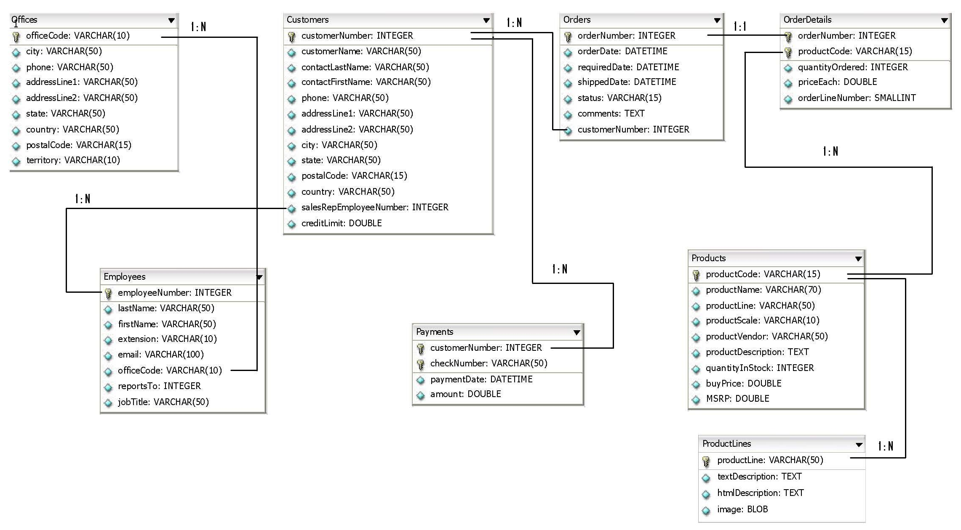
Schema Diagram
6

Slide 8
SELECT Statement
Notes:
We will learn the queries based on the Scenario mentioned and different requirements.

Slide 9
Select Statement
Requirement
How to get last name, first name, and phone number of all customers of ABC Trader’s PMS System.
Query:
SELECT contactLastName, contactFirstName, phone
FROM Customers;
8
Notes:
Explanation:
The query will display last name, first name, and contact number of all customers from Customers table.
When you select specific columns from a table(relation), it is termed as PROJECTION operation in relational algebra.

Slide 10
Select Statement
Requirement
How to get the complete data of all customers in PMS System.
Query:
SELECT * FROM Customers;
If only count of all Customers is required then use the below Query.
SELECT COUNT(*) FROM Customers;
Result is a Scalar Value - the count of number of records.
8
Notes:
Note: The query select * is a bad practice. Never use it in a production environment on tables with huge number of rows.
Usually in projects we do not write query using SELECT *, rather we use SELECT COUNT(*) where COUNT() is a SQL function (to be learnt in another session) that returns the number of records in table.
If the table comprises 122 rows, it will return 122 as a result which is just a scalar value.

Slide 11
Select Statement’s WHERE Clause
Requirement
How to get last name, first name, and phone number of all customers who belong to Germany of PMS System
Query:
SELECT contactLastName, contactFirstName, phone
FROM Customers
WHERE country="Germany";
8
Notes:
Explanation:
The above query will display last name, first name, and contact number of all customers who belong to Germany from customers table.
When you select specific rows from a table(relation), it is termed as RESTRICTION operation in relational algebra.

Slide 12
SELECT Syntax
Retrieving data using SELECT statement is a common task which is done on a daily basis.
The complete syntax of SELECT is given below.
SELECT
[ ALL| DISTINCT] <COLUMN name>[[ AS] <alias>]
[,[ ALL| DISTINCT] <COLUMN name>[[ AS] <alias>]] *
FROM
<table>[[ AS] <alias>|[[ FULL| LEFT| RIGHT] OUTER| INNER] JOIN <table> ON <expression>]
[, <table>[[ AS] <alias>|[[ FULL| LEFT| RIGHT] OUTER| INNER] JOIN <table> ON <expression>]] *
[WHERE <predicate>[{ AND| OR} <predicate>]*]
[GROUP BY <COLUMN name>[, <COLUMN name>]*
[HAVING <predicate>[{ AND| OR} <predicate>]]*]]
[ORDER BY <COLUMN name>[ ASC| DESC][, <COLUMN name>[ ASC| DESC]]*]
[FETCH FIRST <count> ROWS ONLY]
14
Notes:
Explanation
The SELECT statement has many optional clauses:
SELECT clause specifies columns to retrieve.
FROM clause defines the table(s) that is used for the query. It can also join tables.
WHERE clause influences the rows the query returns. It filters the rows applying predicates on it. A predicate specifies conditions that can be true or false.
GROUP BY clause group rows sharing a property so that an aggregate function can be applied to each group.
HAVING clause selects from the groups defined by the GROUP BY clause.
ORDER BY clause specifies an order in which to return the rows.
Note: JOIN, GROUP BY, HAVING, and ORDER BY clause will be discussed in upcoming sessions.

Slide 13
INSERT Statements
Notes:
We will learn the queries based on the Scenario mentioned and different requirements.

Slide 14
INSERT Statement
Requirement
How to perform record insertion in the Employee table of PMS system.
Query:
INSERT INTO EMPLOYEES
VALUES (1703,"Jones","Smith","x19200",
"sjones@classicmodelcars.com",4,1101,"Sales Rep");
8
Notes:
Explanation:
The above query will add a new employee named Smith Jones with id 1703, designation Sales Representative, who reports to employee 1101. His email id and extension are sjones@classicmodelcars.com and x19200, respectively.

Slide 15
INSERT Statement
INSERT adds new rows into an existing table.
The INSERT ... VALUES and INSERT ... SET forms of the statement insert rows based on explicitly specified values.
Syntax :
INSERT [INTO] tbl_name [(col_name,...)]
VALUES ({expr | DEFAULT},...)
17

Slide 16
INSERT Multiple Rows
Requirement
How to perform bulk record insertion in the Employee table of PMS system.
Query:
INSERT INTO EMPLOYEES
VALUES
(1703,"Jones","Smith","x19200","sjones@classicmodelcars.com",4, 1101,"Sales Rep"), (1704,“Demur",“Michel","x19200",“michelD@classicmodelcars.com" ,4,1102,"Sales Rep");
8
Notes:
You can insert multiple rows at a time with a single SQL statement using the command below.

Slide 17
INSERT Multiple Rows
Syntax
INSERT [INTO] tbl_name [(col_name,...)]
VALUES ('value-1a', ['value-1b', ...]),
('value-2a', ['value-2b', ...]),
('value-2a', ['value-2b', ...])
8
Notes:
You can insert multiple rows at a time with a single SQL statement using the command below.

Slide 18
INSERT Multiple Rows
Query
To insert multiple records from the Employee table to the Employee_Copy table and retain the same structure, you can use the below query:
INSERT INTO Employee_Copy
SELECT * FROM Employee;
Syntax
INSERT [INTO] tbl_name [(col_name,...)]
<SELECT Query>
20
Notes:
You can insert multiple rows at a time from one table to another, provided, the columns which are being copied are compatible with each other.

Slide 19
UPDATE and DELETE Statements
Notes:
We will learn the queries based on the Scenario mentioned and different requirements.

Slide 20
UPDATE Statement
Requirement
In Employee Table, the extension for employee 1703 has been changed. But it still shows old data which needs to be updated.
Query:
UPDATE Employees
SET extension ='x19320'
WHERE employeeNumber='1703’;
UPDATE statement changes the data of one or more records in a table.
Either all the rows can be updated, or a subset may be chosen using a condition.
8
Notes:
Explanation: The extension for employee 1703 has been changed to x19320.

Slide 21
UPDATE Statement
Syntax:
UPDATE table_reference
SET
col_name1={expr1|DEFAULT}
[,col_name2={expr2|DEFAULT}] ...
[WHERE where_condition]
23

Slide 22
DELETE Statement
Requirement
In Employee Table, the record of employee 1703 is no more required and needs to be removed.
Query:
DELETE
FROM Employees
WHERE employeenumber=1703;
DELETE statement removes one or more records from a table.
A subset may be defined for deletion using a condition, otherwise all records will be removed.
Some DBMSs, like MySQL, allow to delete rows from multiple tables with one DELETE statement (this is sometimes called multi-table DELETE).
8
Notes:
Explanation: The record of employee 1703 has been removed from employee table

Slide 23
UPDATE Statement
Syntax:
DELETE
FROM table_name
[WHERE condition];
23

Slide 24
Practice Check
Refer DDL,DCL,DML,TCL-practice.pdf document file
24

Slide 25
Recap
In this chapter we have learnt how to:
Write at least 1 Select statement with or without to fetch data from the table.
Write at least 1 Insert Statement with Single or Multiple values into the table.
Write at least 1 Update Statement for Single or Multiple rows of the table.
Write at least 1 delete Statement to delete records from table for a condition.

Slide 26

Source
http://en.wikipedia.org/wiki/Data_definition_language
http://en.wikipedia.org/wiki/Data_manipulation_language
http://en.wikipedia.org/wiki/Data_control_language
http://en.wikipedia.org/wiki/Transaction_Control_Language
Disclaimer: Parts of the content of this course is based on the materials available from the Web sites and books listed above. The materials that can be accessed from linked sites are not maintained by Cognizant Academy and we are not responsible for the contents thereof. All trademarks, service marks, and trade names in this course are the marks of the respective owner(s).

Slide 27
You have successfully completed the session on DDL, DML Statements.
67

